Slide 1
The Future of Nuclear
Professor Emeritus Edward A. Friedman
Stevens Institute of Technology
April 8, 2026, American Nuclear Society Stevens Chapter

Slide 2
Nuclear History – Radioactivity Discovered
In 1896, Henri Becquerel discovered that when uranium salts were wrapped in black paper in a dark location, they caused blackening of photographic plates. He concluded that the uranium salts were emitting some type of invisible radiation.
In 1898, Marie and Pierre Curie discovered two additional elements that emitted radiation. These were polonium and radium
In 1902, Ernest Rutherford and Frederick Soddy determined that the emanation of radioactivity evolved over time in an exponential fashion. From measuring the heat generated by the radioactive decay they calculated the enormous energy available in the nucleus
In 1913, H. G. Wells wrote, “The World Set Free” He anticipated the development of atomic energy in 1933 and of atomic weapons in 1956

Slide 3
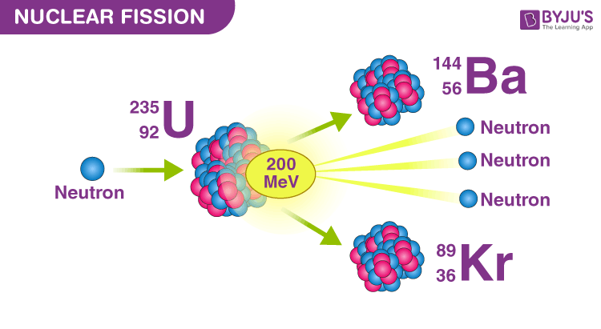
Fission Reaction

Slide 4
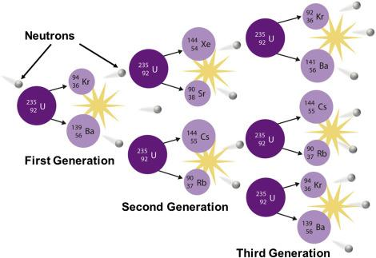
Fission Reaction

Slide 5
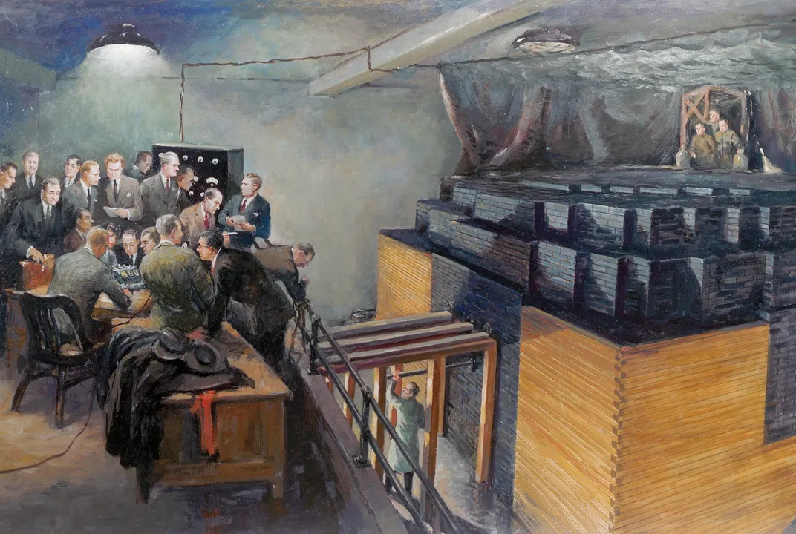
First Reactor – Fermi- December 2, 1942

Slide 6
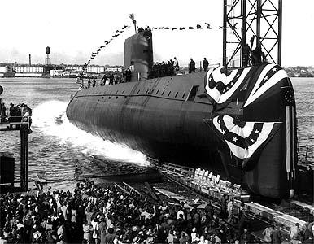
Nautilus Launch 15 January 1955

Slide 7
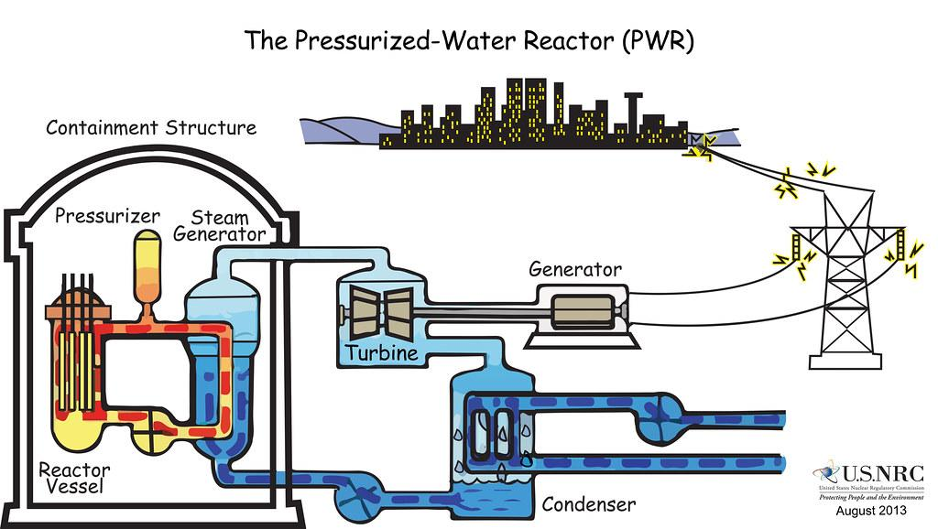

Pressurized water reactor
This Photo by Unknown Author is licensed under CC BY-SA-NC

Slide 8
The Three Major Accidents
Three Mile Island - March 28, 1979
Came close to having a hydrogen explosion
Chernobyl - April 26, 1986
Steam explosion and hydrogen explosion
Fukushima - March 11, 2011
Multiple hydrogen explosions

Slide 9
Global Nuclear Reactor Startups, 1960–2000
Reactors connected to the electrical grid, worldwide — IAEA PRIS data
1960s — Early commercial era
1970s — Rapid expansion (oil crisis orders)
1980s — Peak decade (33/yr in 1984–85)
1990s — Post-Chernobyl decline
Source: IAEA Power Reactor Information System (PRIS)

Slide 10
Following Reactor Construction Hiatus 1986 – 2000
Generation IV International Forum Established - January 2000
International Collaboration to develop safe, economical reactors.
Nine Countries – United States, Argentina, Brazil, Canada, France, Japan, the Republic of Korea, the Republic of South Africa, and the United Kingdom
Joining this group subsequently were five additional members – Switzerland, Euratom, China, Russia and Australia
Now based in Nuclear Energy Agency of the Organization of Economic Cooperation and Development (OECD) in Paris with more than 30 members.

Slide 11
Generation IV International Forum - History
In first two years 100 experts evaluated 130 design concepts against four overarching goals:
Sustainability 2. Economics 3. Safety 4.Proliferation Resistance
Six designs were identified with four being actively pursued:
1. Liquid Sodium Cooled
2. Liquid Lead Cooled
3. Helium Gas Cooled
4. Molten Salt Cooled

Slide 12
Generation IV Nuclear Reactors
International Initiative - Guidelines - 2001
A fail-safe technology
No need for pressure containment to keep water from boiling
Easily manageable waste–no deaths from waste in past or anticipated
Bomb grade plutonium and toxic waste used as low-cost fuel
Modular construction in factories reduces cost of fabrication
No danger of steam explosions
No danger of hydrogen gas explosions
Problems of weapons proliferation avoided

Slide 13
Current Status
More than 50 companies world-wide developing new nuclear reactor designs
-------------------------------------------------------------------------------------
*Bill Gates Company TerraPower is building Natrium, a liquid sodium cooled reactor in Wyoming. Has potential to replace dozens of coal fired power plants, keeping electricity producing and distributing infrastructure in place.
*Kairos Power is building a Fluoride Salt cooled reactor in Oak Ridge, Tennessee
*China and Russia are pursuing lead-bismuth cooled reactors
*China built the first helium cooled reactor in 2023

Slide 14
Recent Developments - February 2026
China began construction of the Xuwei nuclear energy complex to provide power for petrochemical manufacturing that incorporates a helium cooled Generation IV reactor. With these power plants that can operate at 1000 degree Celsius, 11% of the world’s greenhouse gases can be eliminated. Solar and wind are unable to achieve this temperature.
Such reactors have the potential of producing economical hydrogen that can be used at even higher temperatures to process steel and concrete which today each account for about 8% of the world’s greenhouse gases.

Slide 15
New Initiatives
October 2025 - the US Department of Energy is providing up to $80 billion to Westinghouse for construction of 8 - 1000 Megawatt electric pressurized water reactors.
China built 37 reactors during the past decade while the US built 2! With a 6.3 year construction time - compared with 9.4 year average. Currently 32 reactors are under construction in China.
Russia has 36 operational reactors with 7 under construction with 33 operating in foreign countries and 20 under construction. Russia is pursuing a $30 billion nuclear project in Egypt with $25 billion loan and is engaged in discussions with 11 other African countries,
France has a program in which French engineers regain nuclear savvy through immersion in Chinese construction programs. One wonders if Westinghouse should be engaging in a similar initiative.

Slide 16
Greenhouse Gas Emissions
Electricity and Central Heating 31%
Direct heat for metals, chemicals, and cement 12%
Transportation for road, air, and shipping 15%
Agriculture 11%
Building heating and cooling 6%
Chemical processing – cement production 6%
Forestry 6%
Waste – landfills, wastewater 3%
Other 10%
Total 100%

Slide 17
World Reactor Production
Currently about 400 reactors provide 10% of world’s electricity
During the past decade (2015-2025) 72 reactors went online
These were constructed by the following countries:
  China 43
  Russia 14
  South Korea 8
  India 3
  U. S. 2
  France 2
  Total 72
  Other countries with production capacity: Japan, Canada, United Kingdom

Slide 18
References:
Nuclear Energy: Boom, Bust, and Emerging Renaissance
Oxford University Press, 2025, Edward A. Friedman
“Nuclear Tomorrow” Substack - by Edward A. Friedman
A monthly update on nuclear developments
https://www.nucleartomorrow.com/
Edward A. Friedman address: friedman@stevens.edu

